Slide 1


DATA ANALYSIS FOR
SOCIAL BUZZ

Slide 2


Today's agenda
Project recap
Problem
The Analytics team
Process
Insights
Summary

Slide 3

The project entails Accenture assisting Social Buzz, a burgeoning company, in several key areas to facilitate their growth and success.
Firstly, as Social Buzz aims to complete an IPO by the end of the following year, Accenture is providing guidance to ensure a smooth transition into the public market. This involves strategic planning, compliance assistance, and market positioning to enhance investor confidence.
Secondly, as Social Buzz faces challenges in managing their current scale with limited resources, Accenture is stepping in to provide expertise in operational efficiency and scalability. Instead of hiring more personnel, Social Buzz seeks Accenture's support in optimizing their processes and infrastructure.
Lastly, given the vast amount of data inherent in Social Buzz's operations, they aim to adopt data best practices from leading corporations. Accenture is facilitating this by imparting insights into how major companies manage big data challenges, enabling Social Buzz to leverage their data effectively for informed decision-making and innovation. Overall, Accenture's involvement underscores a strategic partnership aimed at propelling Social Buzz towards sustainable growth and success.
Project Recap

Slide 4

Scaling Issues: With over 500 million active users monthly and a rapid growth trajectory, Social Buzz is struggling to manage its scale efficiently. Out of its 250 employees, a significant portion (200) are dedicated to technical roles aimed at maintaining the complex technological infrastructure required to handle vast amounts of unstructured data.
Resource Limitations: Despite their growth, Social Buzz remains a relatively small company without the resources to effectively manage their scale and complex data needs. While they could hire more personnel, they prefer to seek assistance from experienced external firms.
Data Management: The platform generates an enormous volume of data daily, with over 100,000 pieces of diverse content posted regularly, including text, images, videos, and GIFs. Managing and analyzing this data require sophisticated and expensive technology, which poses a significant challenge to the company
Problem

Slide 5



Saisriram kasuba
Data Analyst
The Analytics team
Marcus Rompton
Senior Principle
Andrew Fleming
Chief Technical Architect

Slide 6
Process
1
Data Understanding
2
Data Cleaning
3
Data Modelling
4
Data Analysis
5
Quick Insights

Slide 7
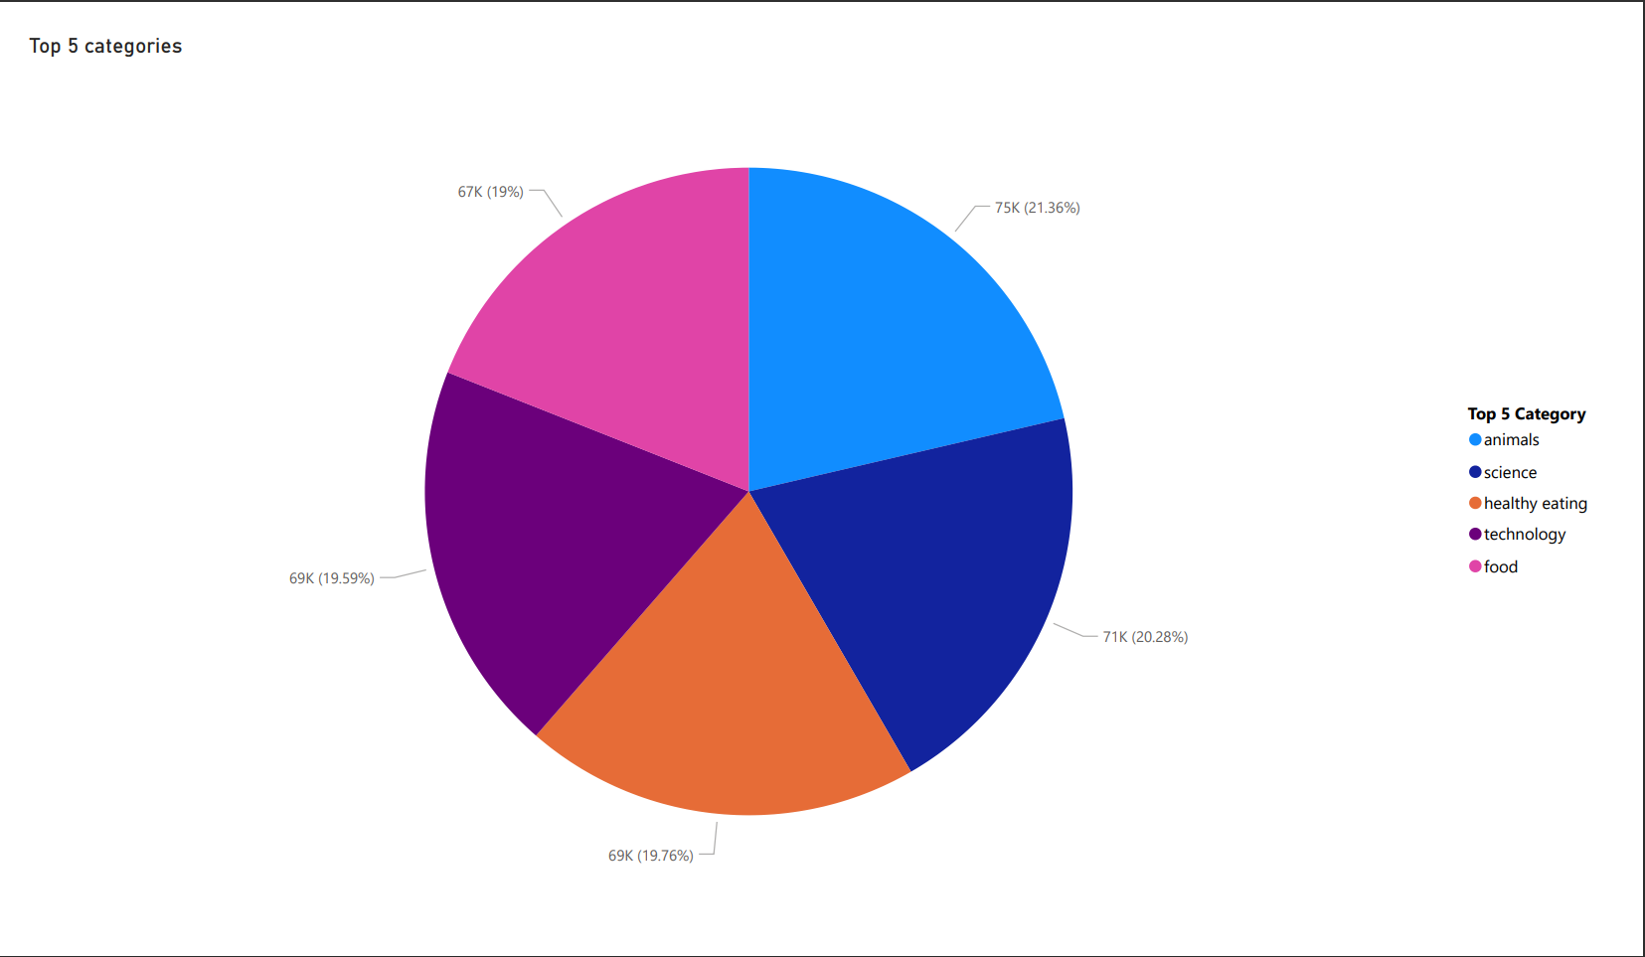

Insights

Slide 8
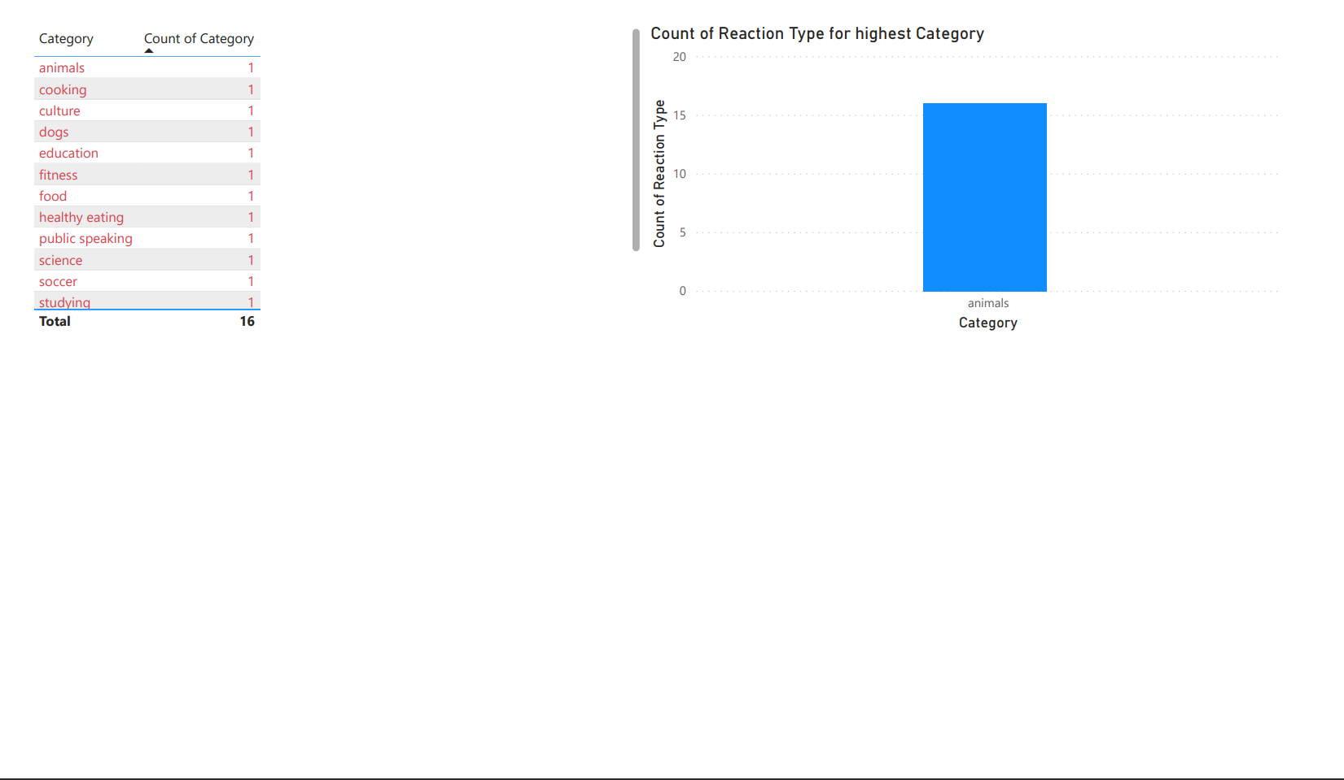

Slide 9
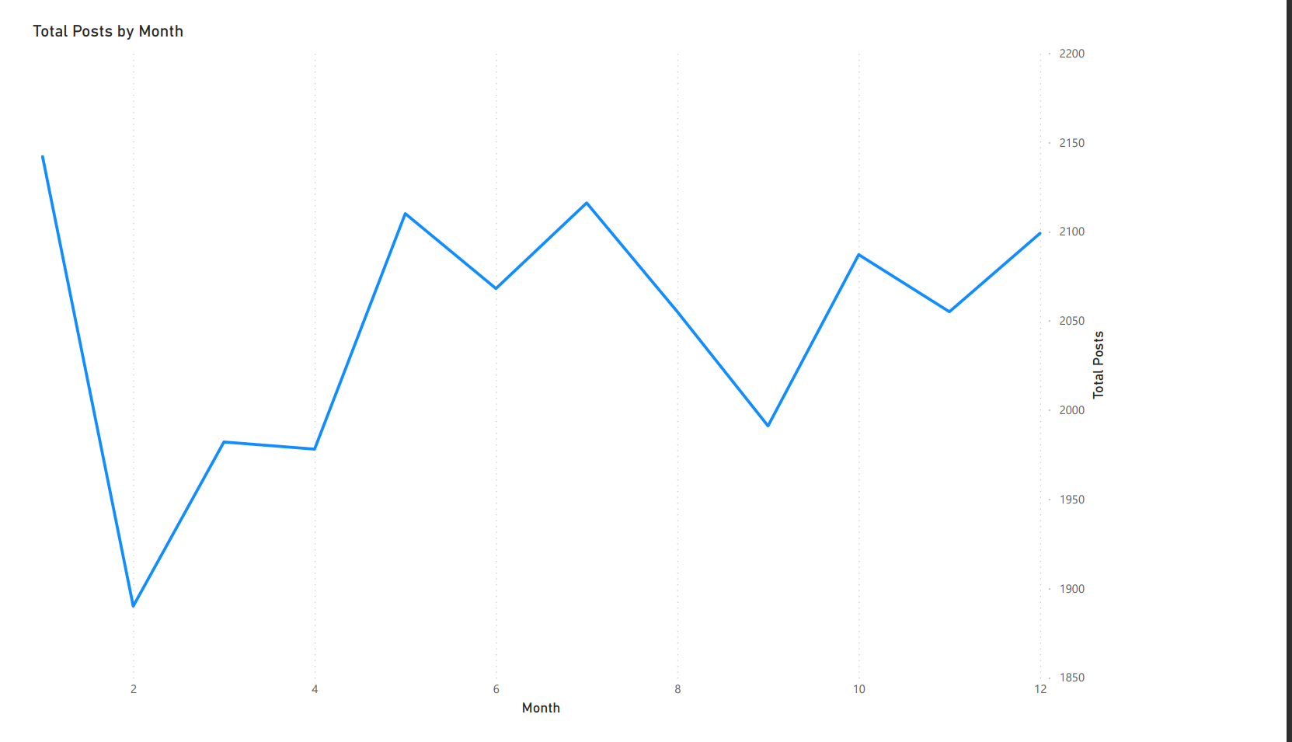

Slide 10
Summary
Social Buzz, founded by former engineers from a major social media conglomerate, has rapidly grown to over 500 million monthly active users. With a focus on anonymous content and diverse user reactions, they face immense data management challenges. Seeking external expertise for their IPO, scalability, and data best practices, they engage Accenture for a 3-month project. Accenture's tasks include auditing their big data practices, offering IPO guidance, and analyzing top content categories. This engagement aims to demonstrate Accenture's capability in addressing Social Buzz's critical needs and establishing a long-term partnership.

Slide 11
Thank you!

